Slide 1
Soprex framework on .NET in action
Milan Vukoje
www.Vukoje.NET
milan.vukoje@soprex.com
August 8, 2011

Slide 2

Themes
What is SCA?
Why we built it?
Architecture overview
  Domain objects
  Data Access Layer
  Business Layer
  Presentation layer
Discussion

Slide 3
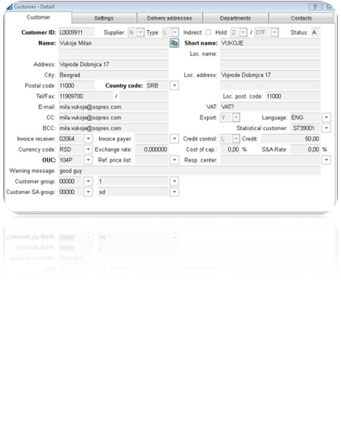
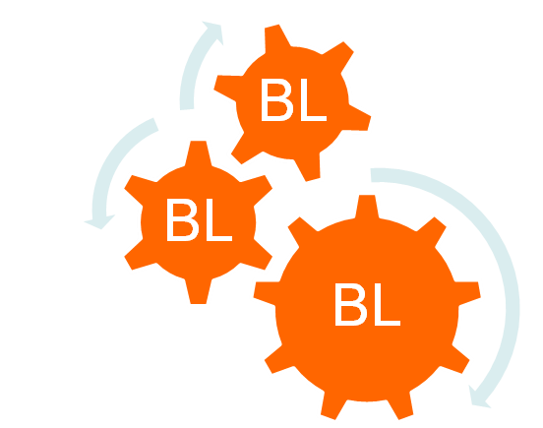


Typical business app
External sys
OLAP
sync
OLTP
sync

Slide 4
Why SCA for Management?
Rapid Application Development
Stability & Predictability
Quality - error probability reduction
High app performance
Usable GUI
Solving problem once
  User management
  Access Rights
  Translation
  Configuration
  …

Slide 5
Why SCA for Developers?
Simple & Uniform solutions
Configuration over custom code
Simple test cases
High code reuse
Executable best practices
Focus on BR

Slide 6






DEMO 1

Slide 7
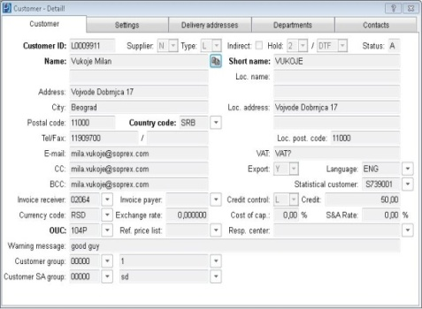

Architecture overview
Is “simply” easy to build?
How to implement a
sure thing?
SOA?
GUI
PL
BL
DAL
First law of distributed object design:
- Don't distribute your objects!
Martin Fowler
DB

Slide 8
Doman Objects (DO)
The choice?
  Parameters (no DO)
  XML
  POCO
  DataTable
  Typed DataTable
  Linq to SQL
  Entity Framework
The winner - POCO + DataTable
GUI
PL
DO
BL
DAL
DB

Slide 9
DO features [1]
Simple API
State
  New
  Modified
  Unchanged
Change Tracking
  Original values
  Change notification
Change control
  Always
  Local only
  New Only
GUI
PL
DO
BL
DAL
DB

Slide 10
DO features [2]
Validation
  Required
  Max length
  Max/ Min value
  …
Serializable
Clone/Copy/Sync
Optimized
Generated from DB
Integrated meta model
Memory DO querying
GUI
PL
DO
BL
DAL
DB

Slide 11
Data Access Layer (DAL)
Key focus is performance!
Isolates DB Dependency
DAAB
Queries vs. Stored procedures
Support for MS SQL and SQLite
No T-SQL in API
No abstract queries
GUI
PL
BL
DAL
DB
All non-trivial abstractions, to some degree, are leaky.
Joel Spolsky

Slide 12
DAL features [1]
CRUD
Filtering
Filter composition
Paging
Paged searching
(Default) Ordering
Simple JOINs
GUI
PL
BL
DAL
DB

Slide 13
DAL features [2]
Batch saving & Importing
Partitioned data loading
Unique rule validation
Unique key generation
GUI
PL
BL
DAL
DB

Slide 14
Meta means murder
Denormalized meta-model
  IsLocal
  CreatedOn
  CreatedBy
  UpdatedOn
  UpdatedBy
  Status
  IsLocked
table columns have translatable description
DBUtil – tool handling redundancy
Soft Delete pros and cons
GUI
PL
BL
DAL
DB

Slide 15
Business Layer (BL)
Implements BR
Validates Data
DB agnostic
Concurrency control
  Pessimistic
  Optimistic
Child DO (lazy) loading
Anemic DO vs. Rich DO
GUI
PL
BL
DAL
DB

Slide 16
Services
AppTranslation
AppProperties
AppUserRights
BL
BL
BL
DAL
DAL
DAL
DB

Slide 17
DEMO 2

Slide 18
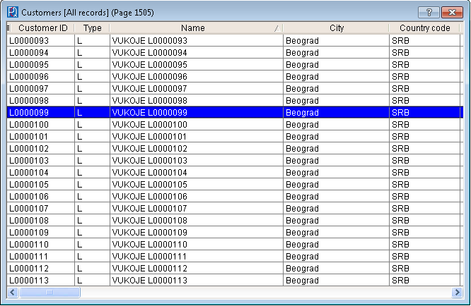
Presentation Layer (PL)
Applies BR to GUI
  Editability
  Data size
Converts GUI actions to BL
actions
Coordinates data loading
  paging/sorting
  filter composition
Controls access rights
Controls actions availability
PL
PL
PL
Presenter
Service
BL
Service
Service

Slide 19
PL features
Implements Presentation Logic
Form customization
  Position
  Size
  Filter
  Gris Settings
Translates messages
Optimistic & Pessimistic concurrency
Optimized
  Partial grid data loading
  Child data lazy loading
GUI
PL
BL
DAL
DB

Slide 20
PL advantages
Unit testable
Keeps BR in BL
Keeps PL out of GUI
GUI agnostic
Easy to have alternative GUI
GUI
PL
BL
DAL
DB

Slide 21
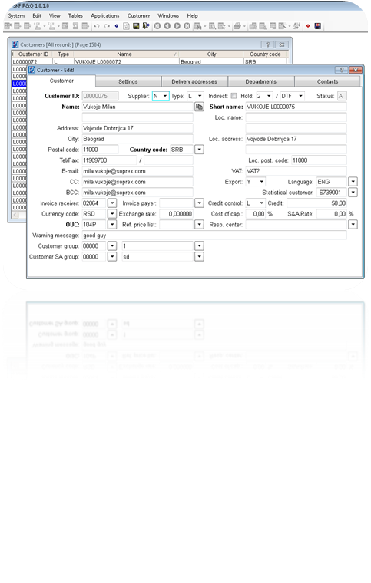
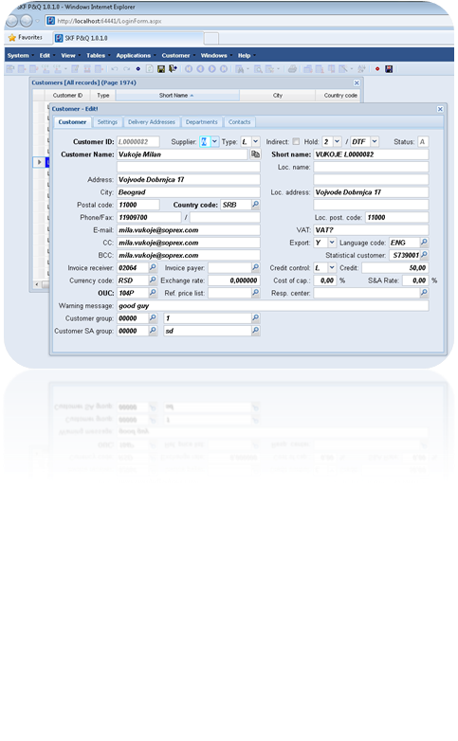
GUI
BIND
DO
LOAD
PL
PO
BIND
Data

Slide 22
GUI
Binding – declarative sync
Minimum amount of logic
Built using designer (not generated)
GUI
PL
BL
DAL
DB

Slide 23

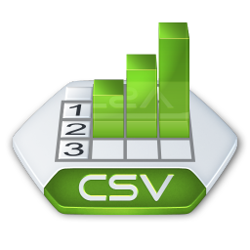
Data Import
Async
Fast
Extensible
Reports BL errors
Respects user settings
Reports format errors
DB
Convert
DataTable
Import
Data editable by User

Slide 24
Profiling
Trace
  Production debugging
  Performance monitoring
  High performance
Event Logger
  Reliable support notification
  Collects reproduction data
    User input
    Trace
    System state

Slide 25
More SCA features
Export
  Excel, CSV, Text, XML, HTML
Printing
  Word/PDF
Mailing
AppCache
Offline app sync
Record Attachments

Slide 26
Summary
Frameworks are nice…
…but they cost money!
Keep it simple, Stupid! (KISS)
Don't repeat yourself! (DRY)
Long live MVP!
Don’t chaise technology

Slide 27
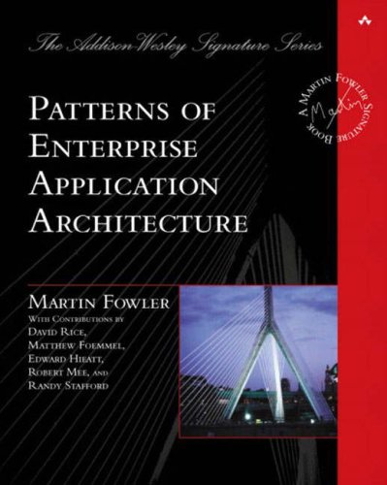
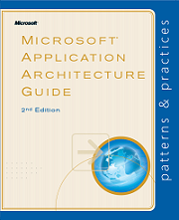
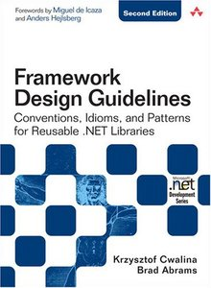
Resources
Patterns of Enterprise Application Architecture
Application Architecture Guide 2.0
Framework Design Guidelines

Slide 28

Questions
Arguing with an Engineer is a lot like wrestling in the mud with a pig:
After a few hours, you realize the pig likes it.

Slide 29
Thank you for your attention.
Milan Vukoje
www.Vukoje.NET
milan.vukoje@soprex.com

Slide 30
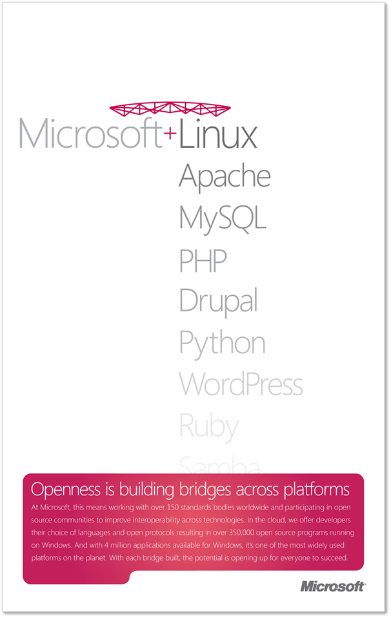
Openness and Interoperability @Microsoft
Microsoft and Open Source
gateway for deeper exploration of open source engagements
http://www.microsoft.com/openness
Port25
blogs from the platform community and the OSS Lab teams
http://Port25.technet.com
Codeplex
resources for developers and consumers of open source projects
http://www.codeplex.com
Interoperability Bridges
technical collaborative works
http://www.interoperabilitybridges.com
Open Up
cross-Industry Interoperability and Standards activities
http://www.microsoft.com/interop/openup
Shared Source
portal for programmatically sharing code
http://www.microsoft.com/sharedsource
OData
open source starter kit for Internet publishing of Government datasets using the Open Data
http://ogdisdk.cloudapp.net
Open Spec
protocols, file formats, standards, technical specifications
http://www.microsoft.com/openspecifications
BizSpark
Program for Start-Up companies from both commercial and open source backgrounds
http://www.microsoft.com/bizspark
How can I receive up-to-date Openness announcements from Microsoft?
In addition to the websites above, you can receive regular updates to Microsoft’s openness, interoperability and standards efforts via the following channels:
http://blogs.technet.com/b/openness/
http://blogs.msdn.com/b/interoperability/
http://twitter.com/OpenAtMicrosoft
http://port25.technet.com
http://channel9.msdn.com/Blogs/Interoperability

Slide 31

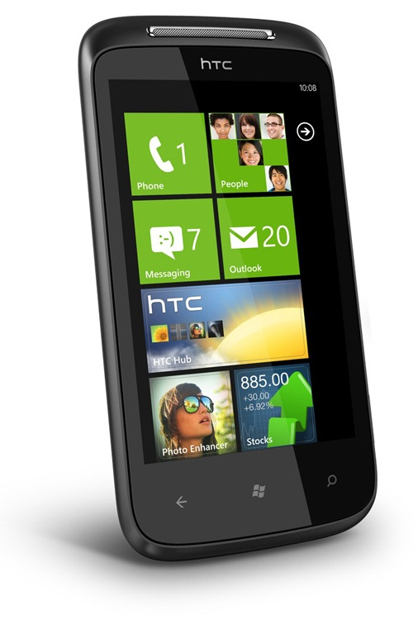


Please rate this lecture
and WIN HTC MOZART!
Help us choose the best Sinergija lecturer! Telekom Srbija and Microsoft will award you – at the conference end, we’ll give one HTC Mozart WP7 phone to someone from the audience – randomly.
Go to www.mssinergija.net, log in and cast your votes.
You can rate only lectures that you were present at, just once. More lectures you rate, more chances you have.
Please use computers at the front of this room, or rate lecture from your phone or home computer, at Sinergija portal.
This prize contest will end at Thursday, October 20th at 9 PM. Winner will be announced at the official Sinergija web portal, www.mssinergija.net
is a friend of Sinergija 2011
Conference and Imagine Cup
student competition in Serbia.

